Slide 1
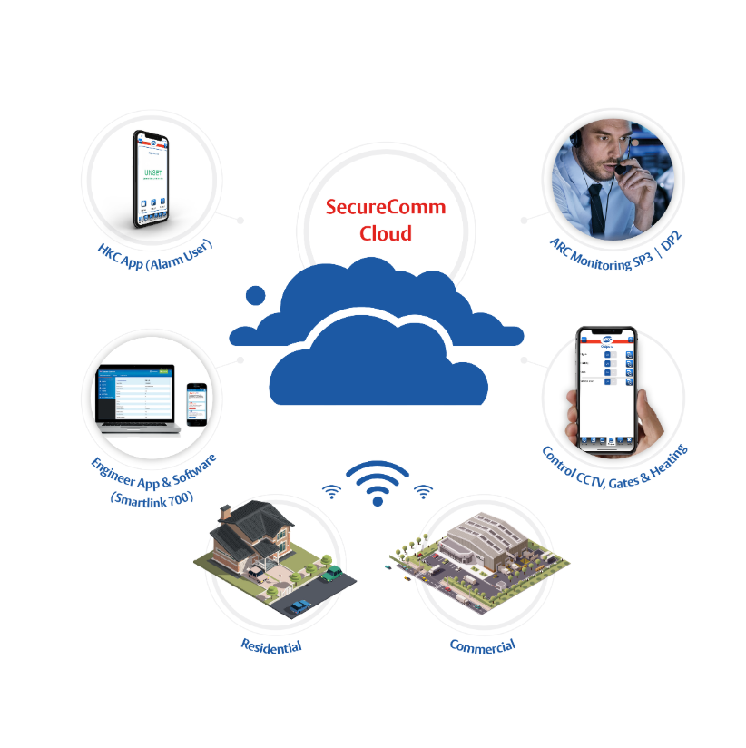
Why HKC?
Reliability
Superb RF Range
Managed Cloud for Recurring Revenue
Excellent Battery Life
Engineer App and Remote Maintenance Software
Alarm User App
Connected Device Capability
The Smart Choice for Professional Installers

Slide 2
Connecting…..Automating…….Signalling
Own Managed Cloud
Easy to use Alarm User App
Dual Path Signalling to all major ARCS
Gate/CCTV Light and Heating automation
Engineer App for Remote Maintenance & full up/down load
App integration with all major CCTV brands

Slide 3
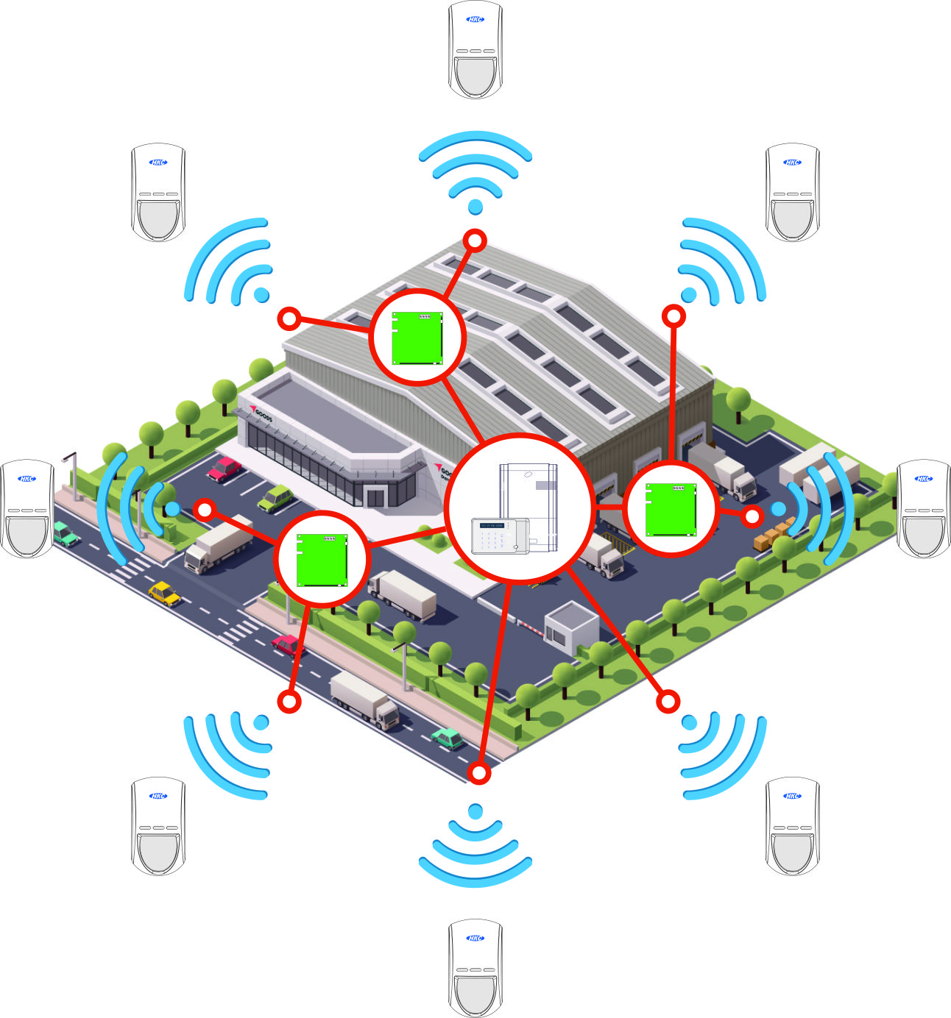
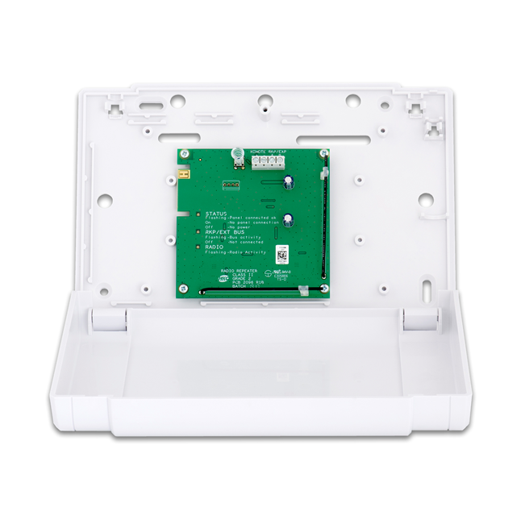
Connecting…..Automating…….Expanding
Wireless for any site. RF Expander Architecture can deliver up to 200 wireless zones
RF Expander
Save time and Money

Slide 4
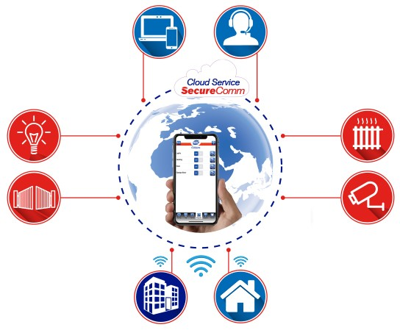
Connecting…..Automating…….Signalling
Superb Technical Support
Dual Path Signalling to all major ARCS
Control and manage Light and Heating
Gate & CCTV automation

Slide 5
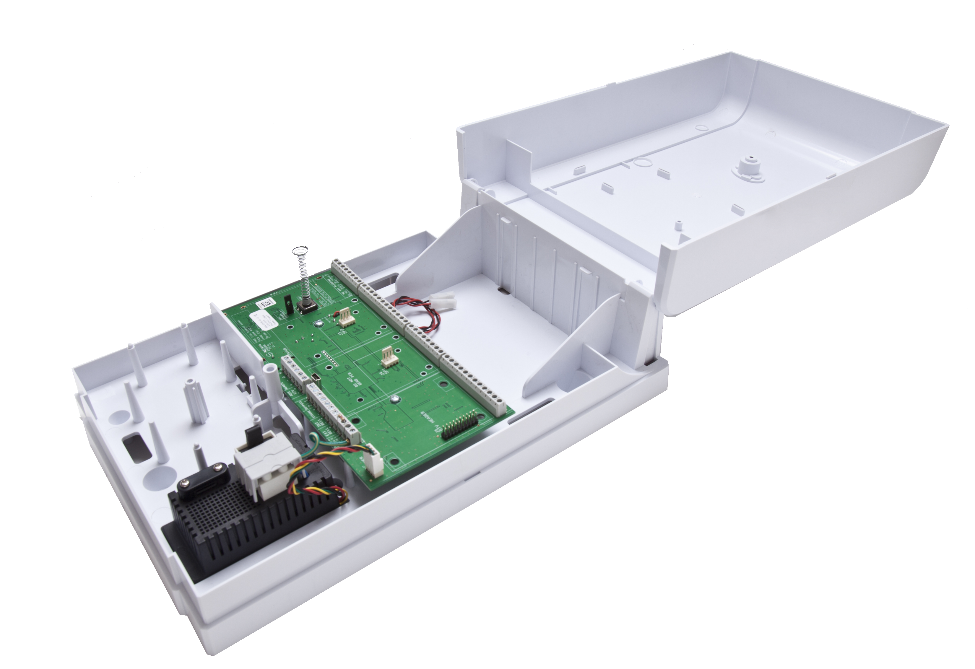
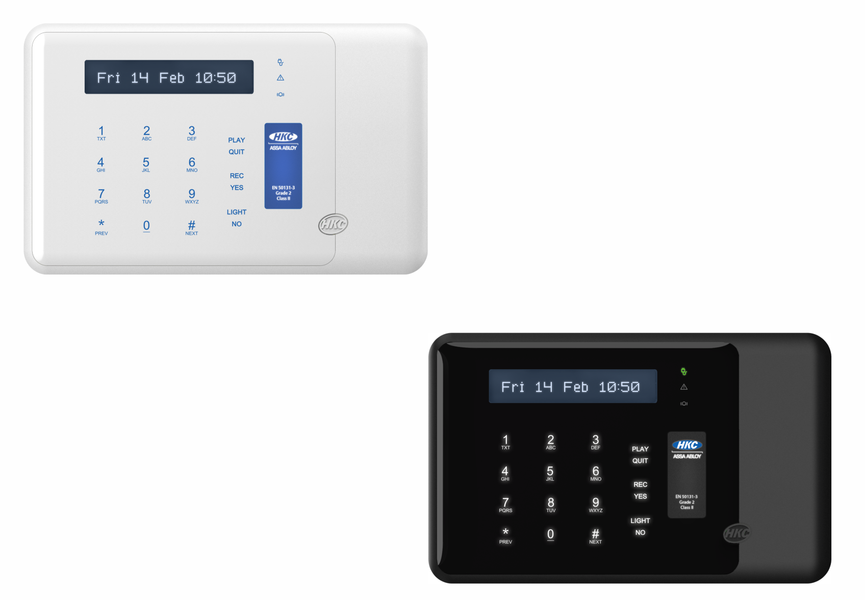
2 Panels For All Solutions Plus Alarm User & Engineer App
70 Wireless Zones ideal for small SME / Residential Installs
Key Features & Benefits
Hybrid Panel includes 10 wired zones (expandable to 140) and 70 wireless zones
(Expandable Up to 200). Combined Wired and Wireless max of 270 zones
Hybrid or Complete wireless panels easy to install and program.
70 Wireless Zones out of the box
Programming is consistent across our range of alarm panels.
Extensive range of wired and wireless alarm detectors to ensure installers can protect properties using perimeter, trap or combined detection.
Resin sealed electronics – more resilient
Wireless and Wired PIRs look identical
Keypad Audio - Voice notification of each zone i.e. ‘Alarm Kitchen Side Door’
2 Way Radio ensure robust communication between control panel and devices
Pricing won’t be on Google – Trade Only
Quantum 70 Packs
SW 10270 Panel

Slide 6
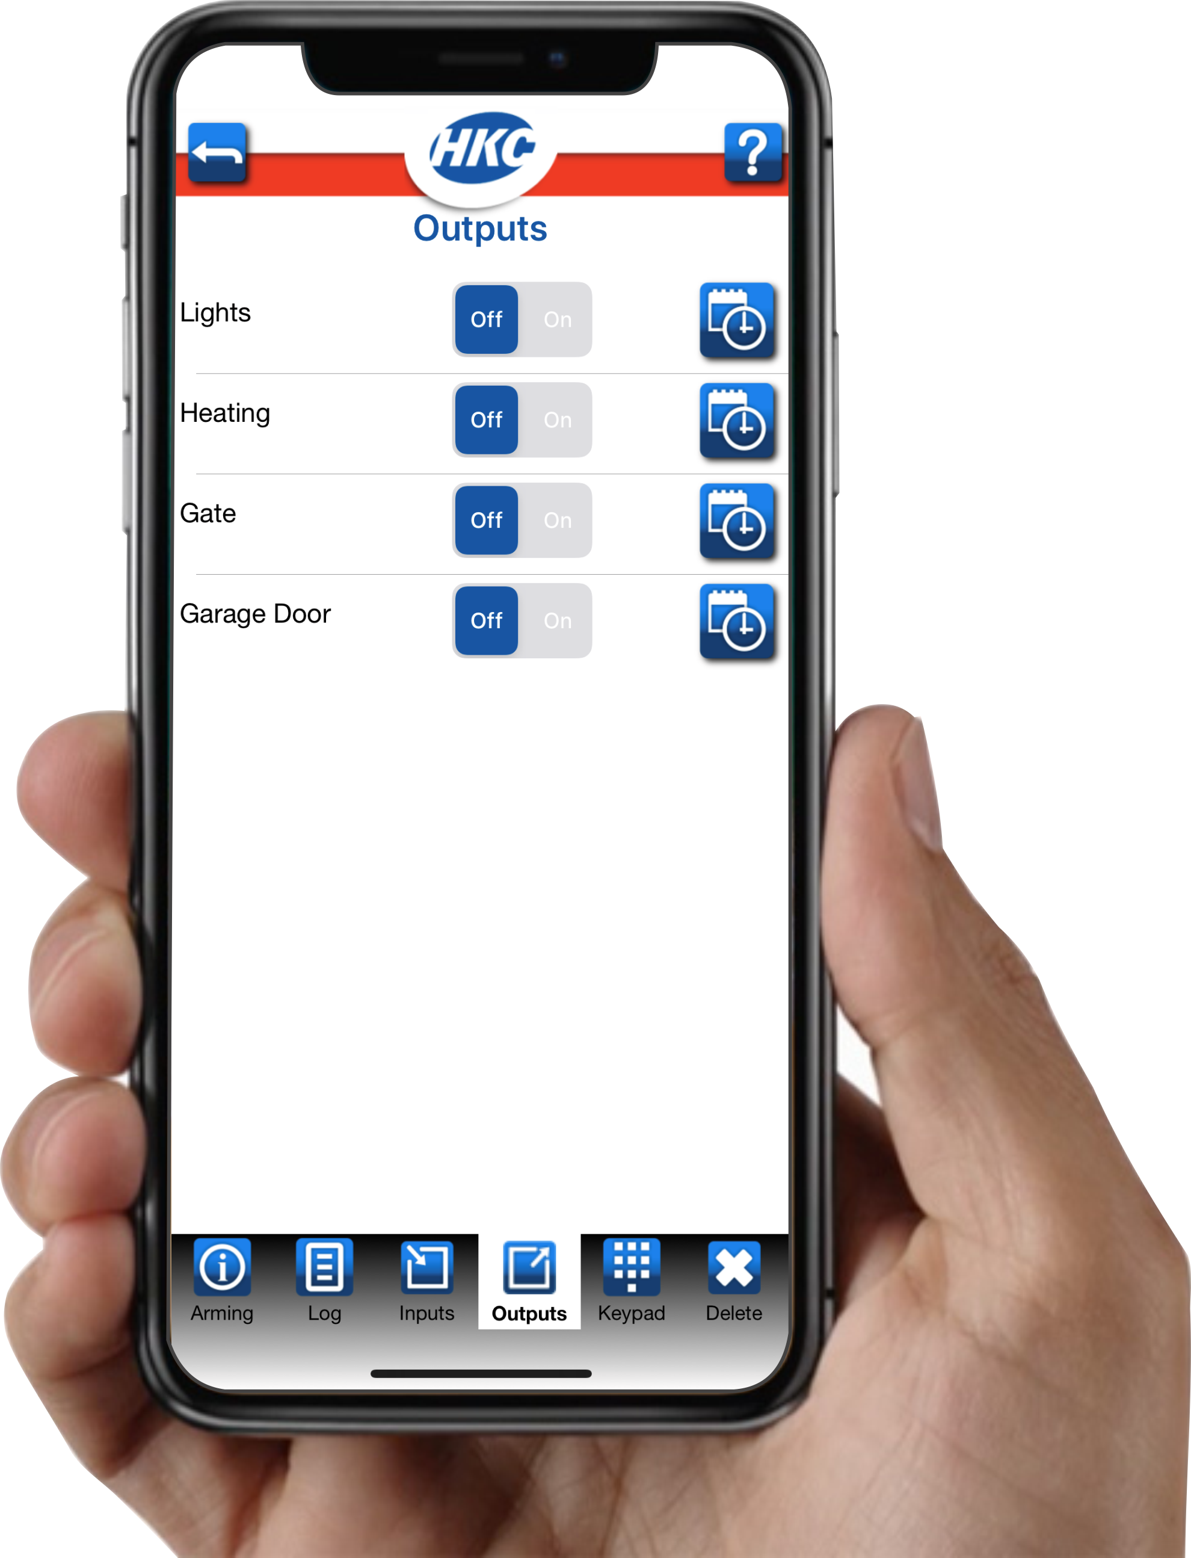
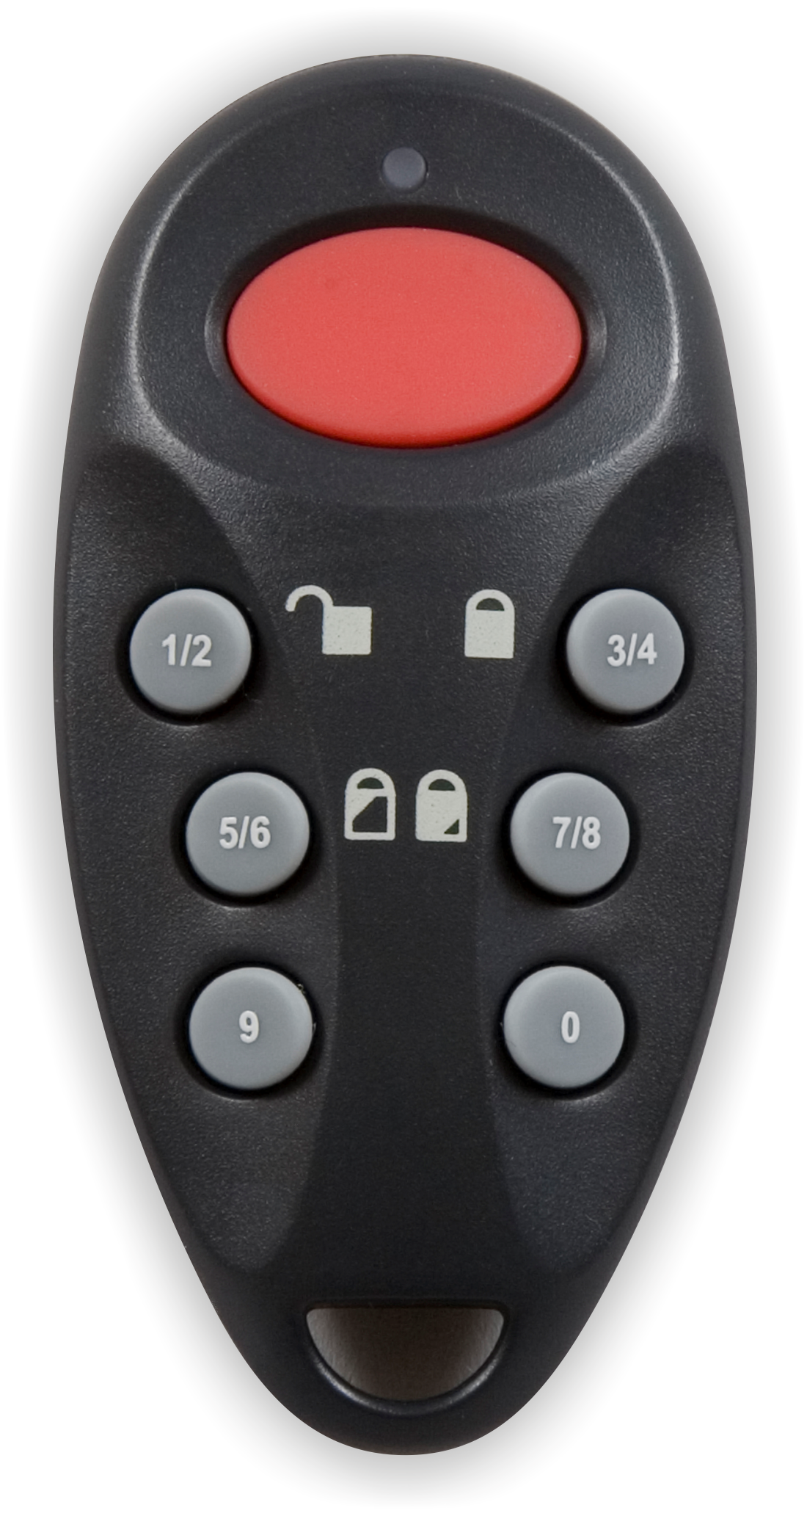
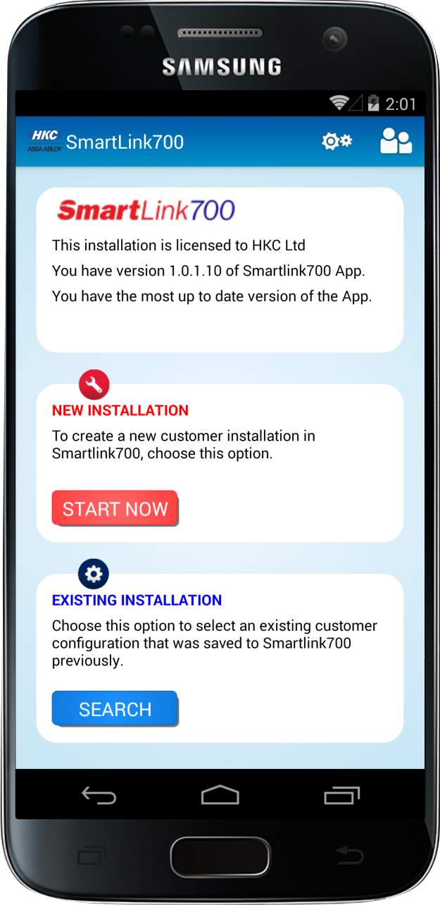
Keypads and Controls
Easy to use App
RF Fob with PA
Proximity Touch Wired and Wireless Keypads
Engineer App…saves time and margin

Slide 7
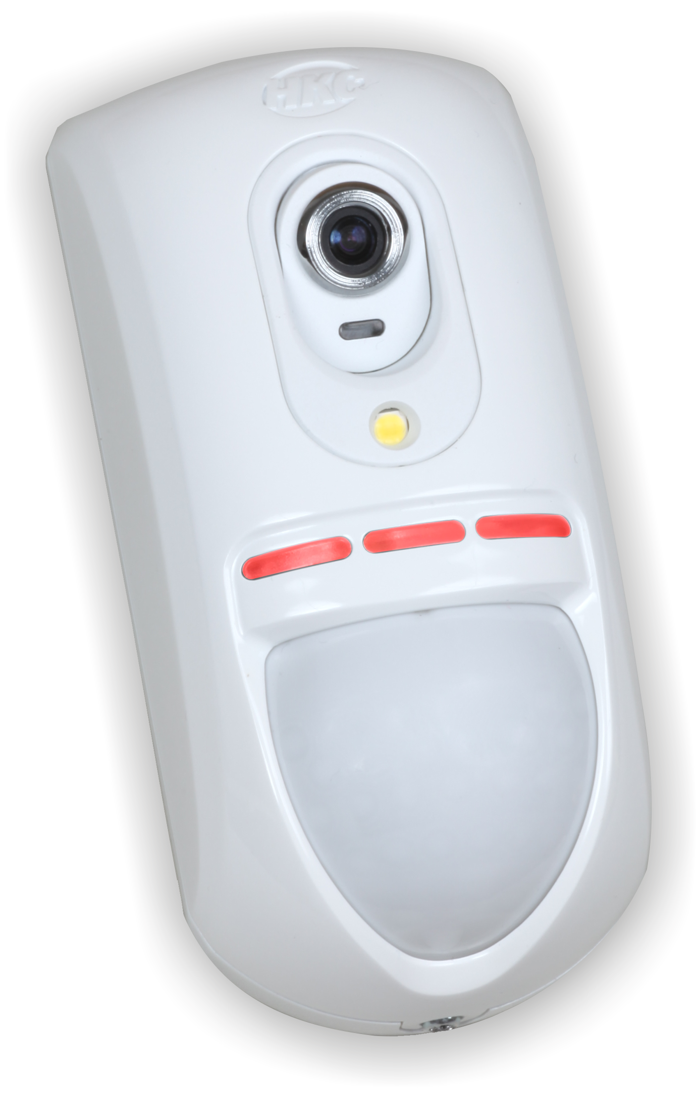
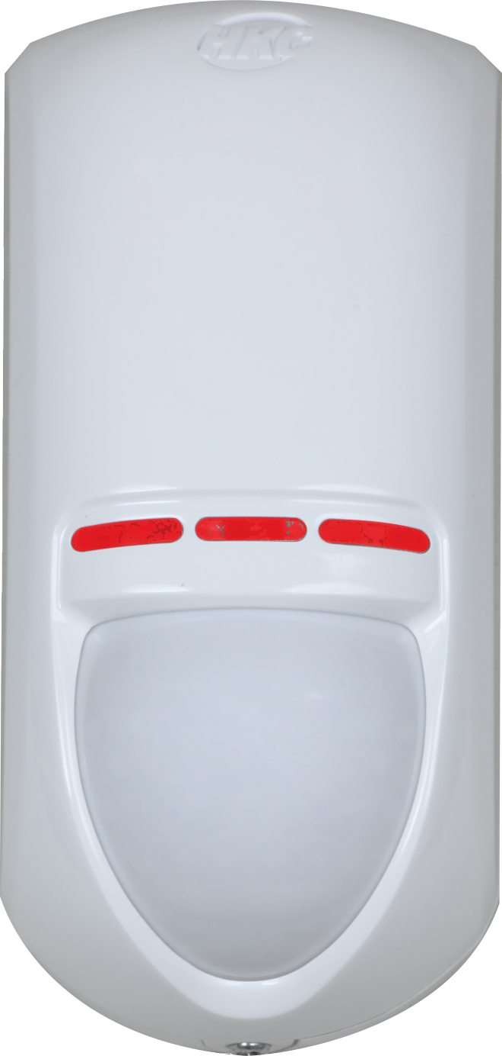
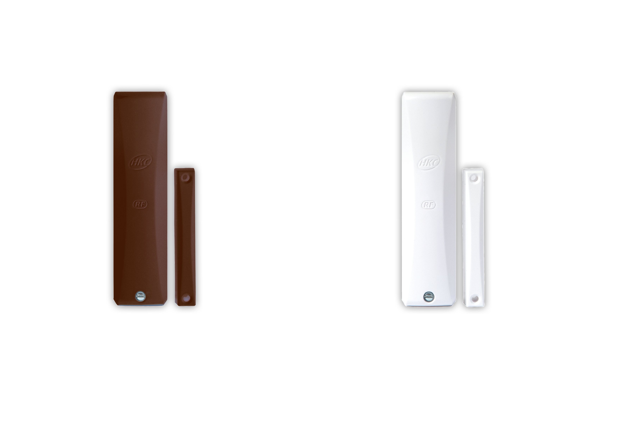
Intrusion Detectors
Turn on lights and Heating remotely
Miniature & Standard Shock Sensors with Contact
Range includes Camera and Dual Tec
Engineer App…Full Up & Down load capability

Slide 8
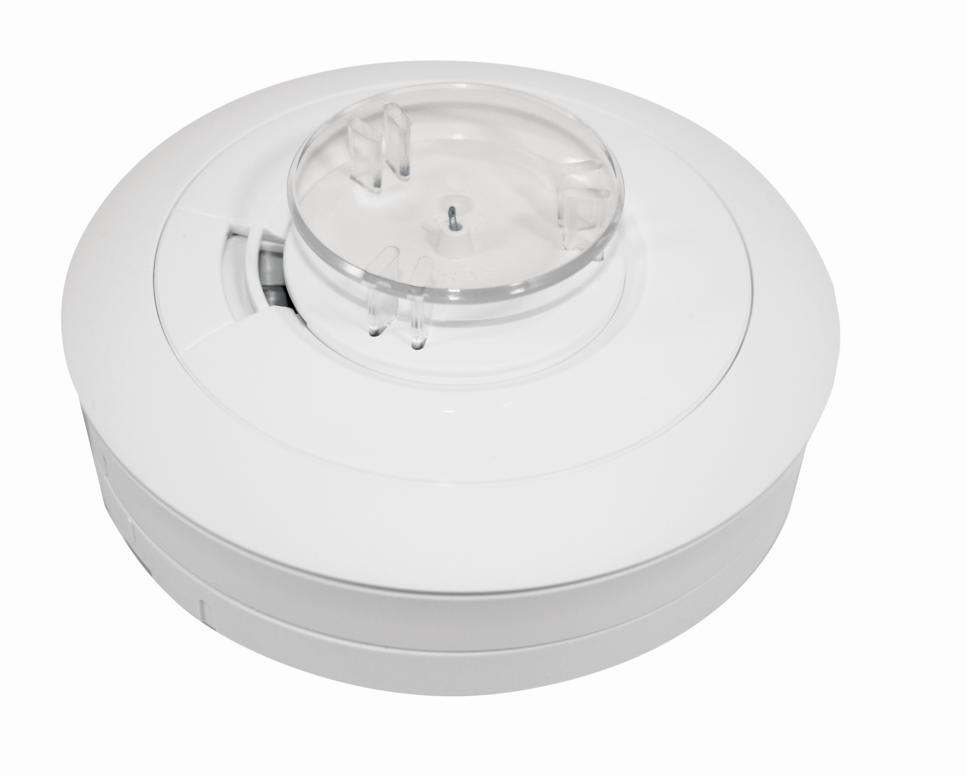
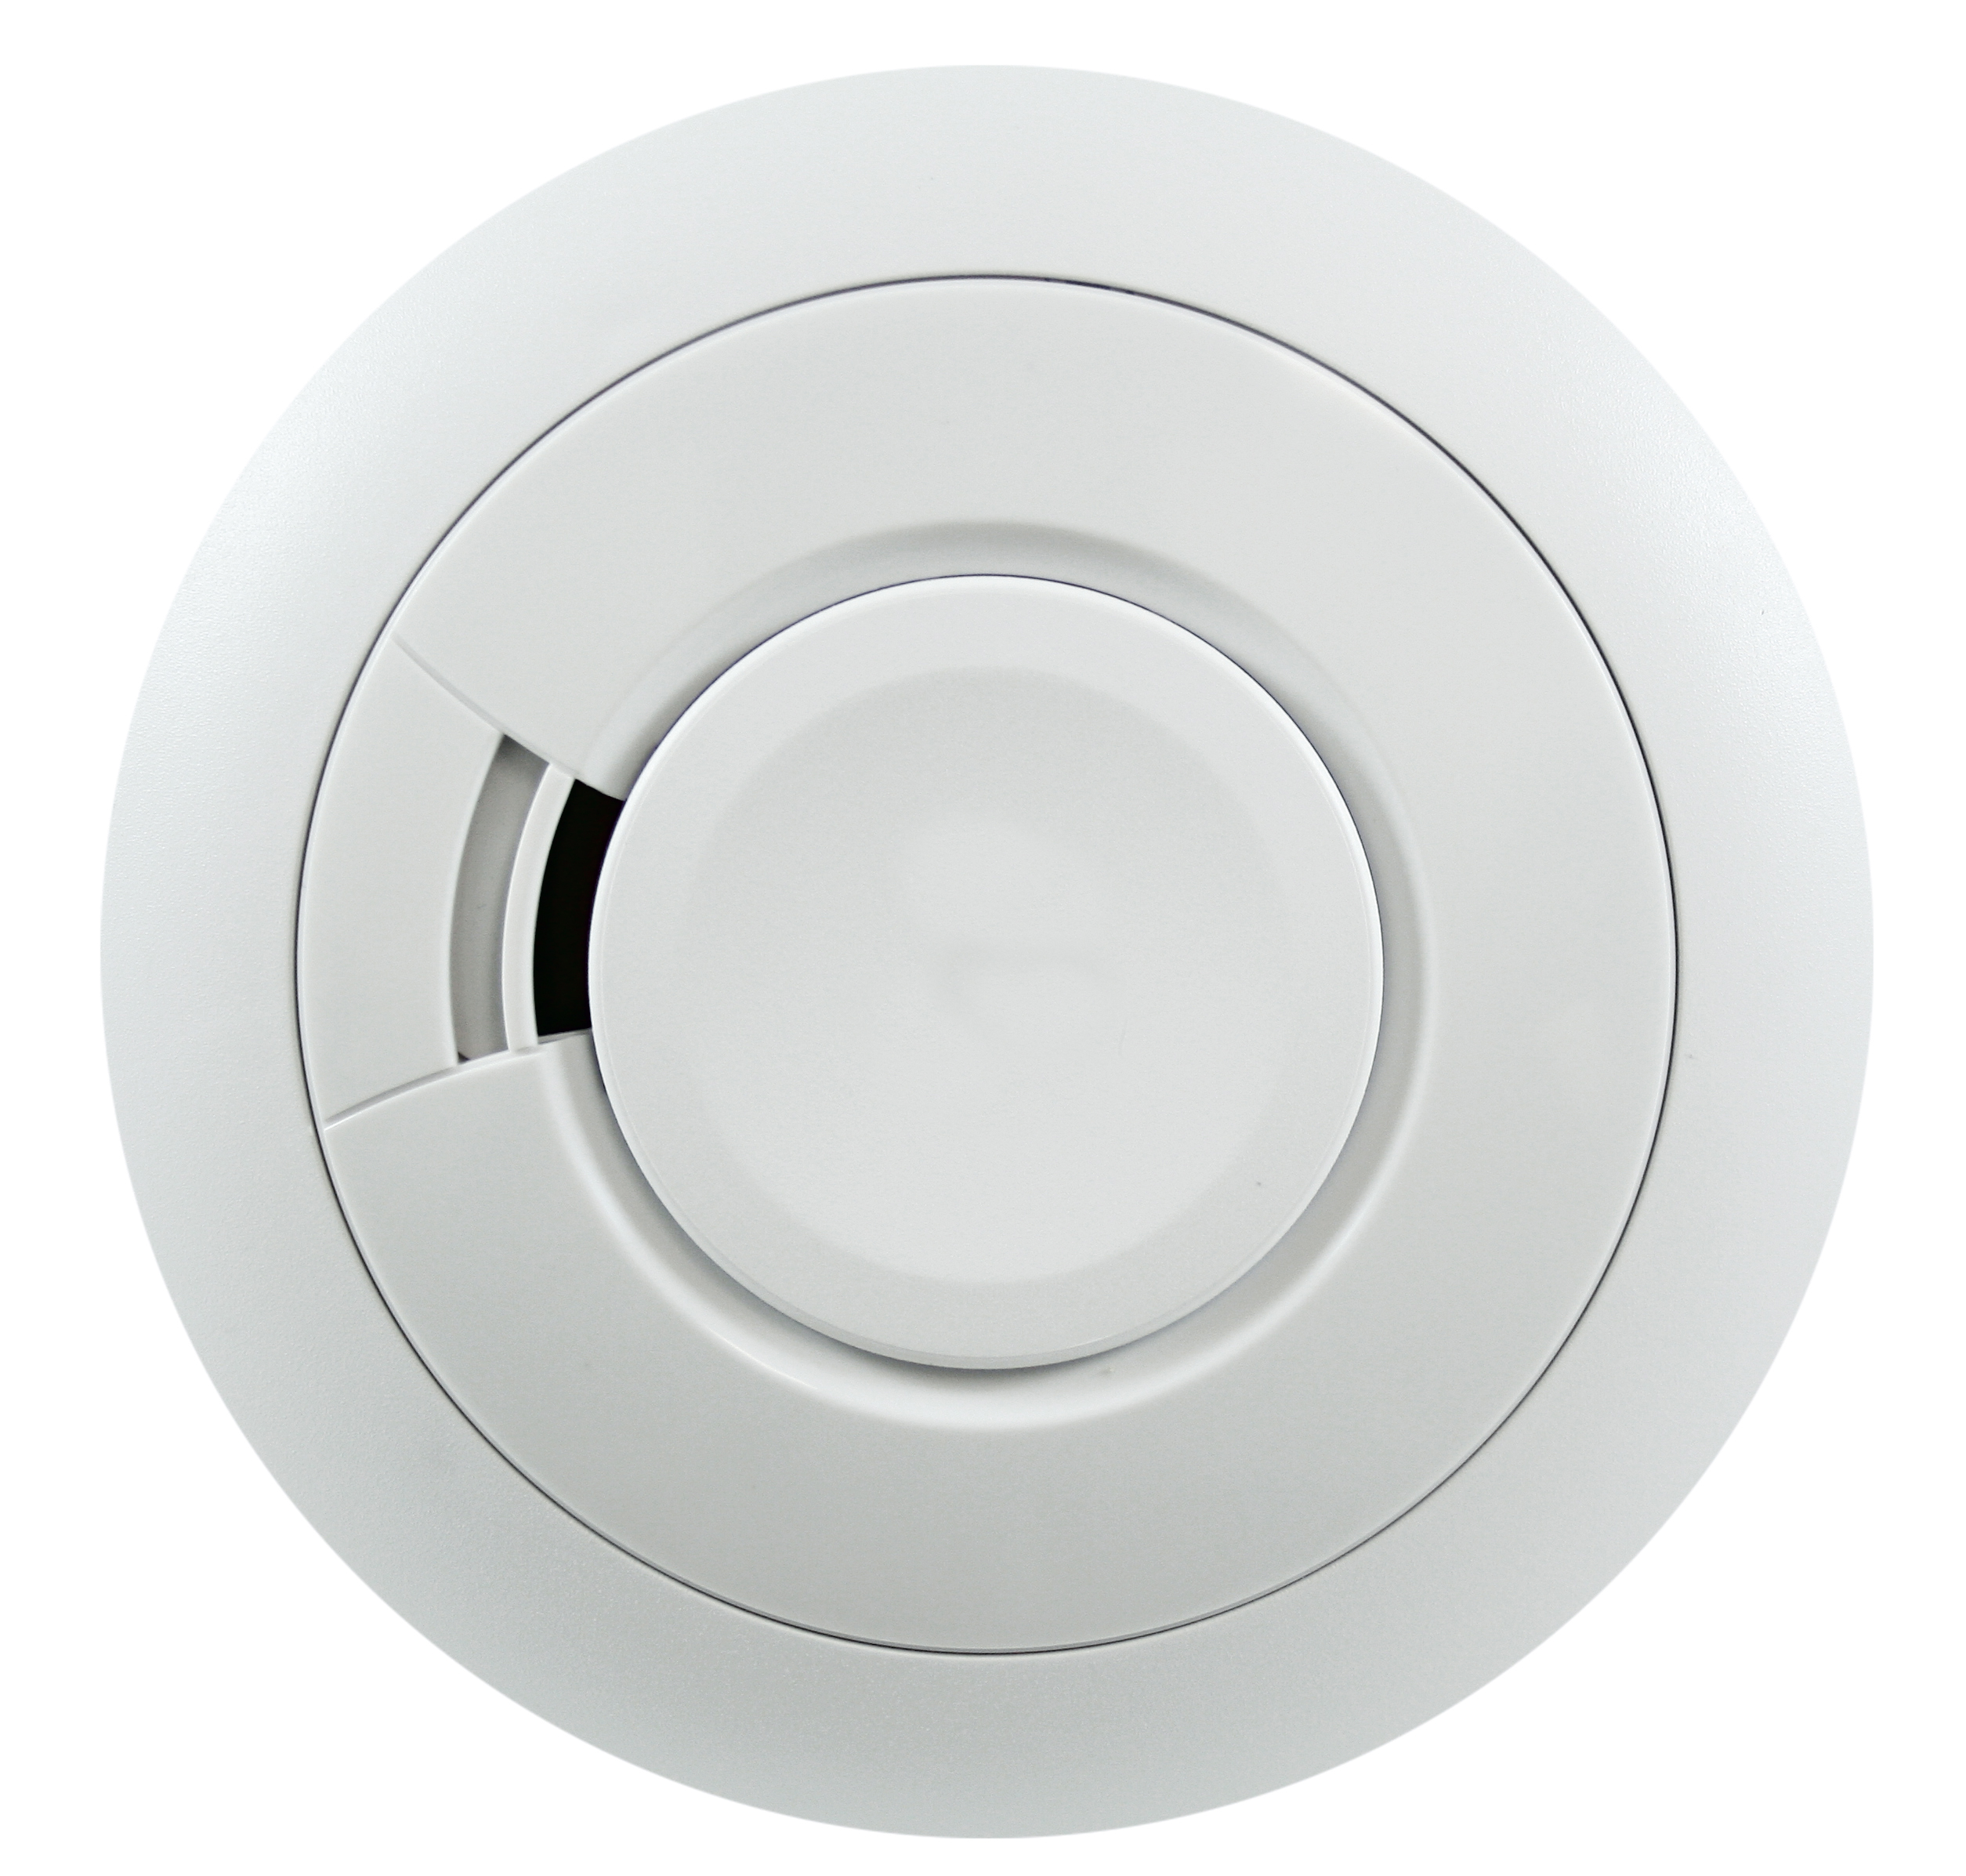
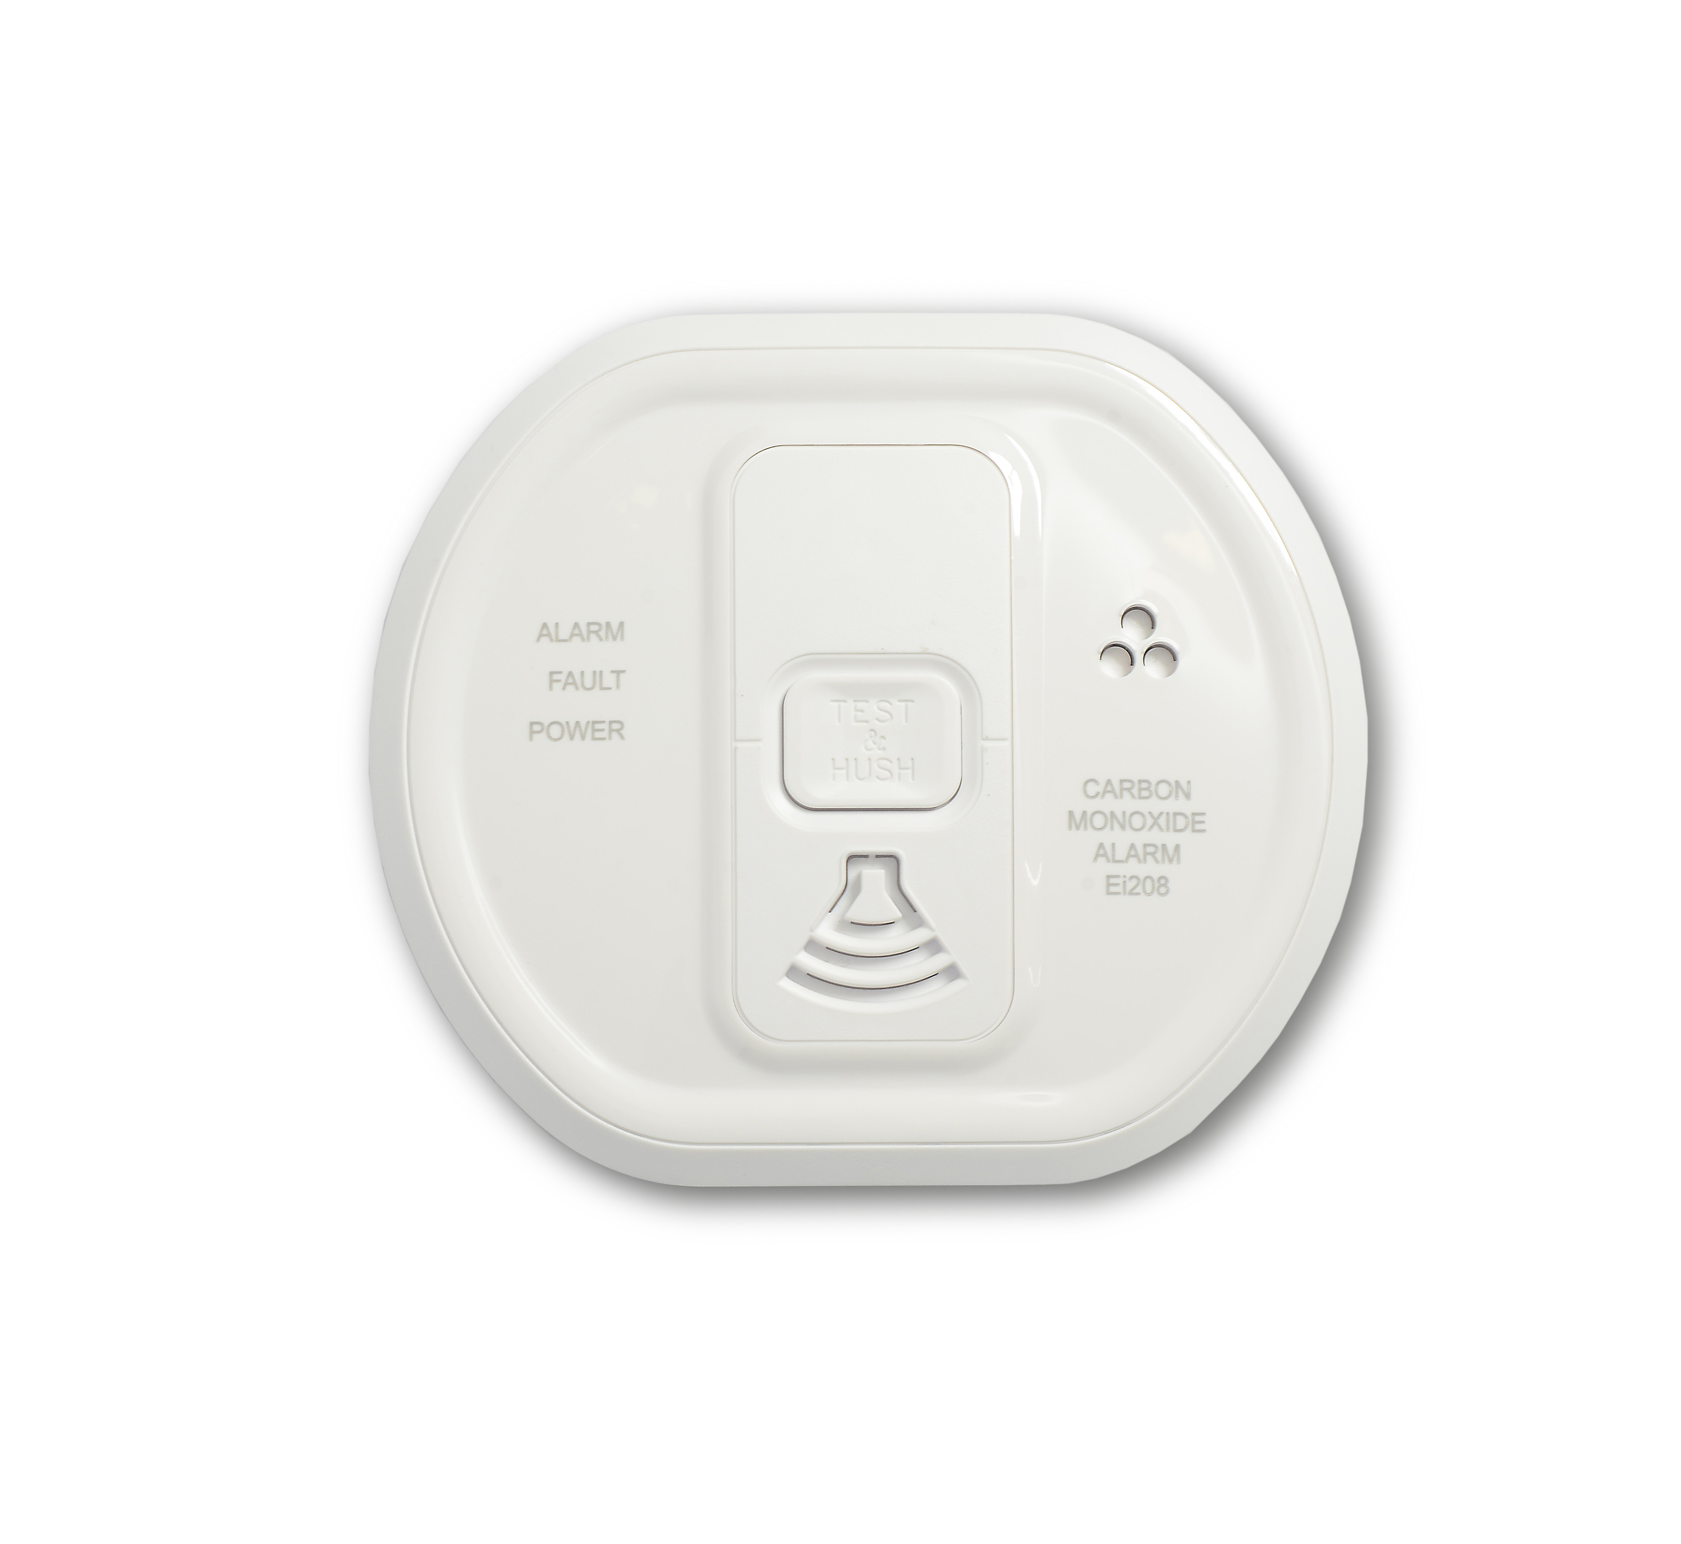
Life Safety
Arm /Disarm or check logs remotely
RF Fob with PA
Dual Button Push PA
Engineer App…Carry out diagnostics and change settings
Smoke, Heat and CO Detectors

Slide 9
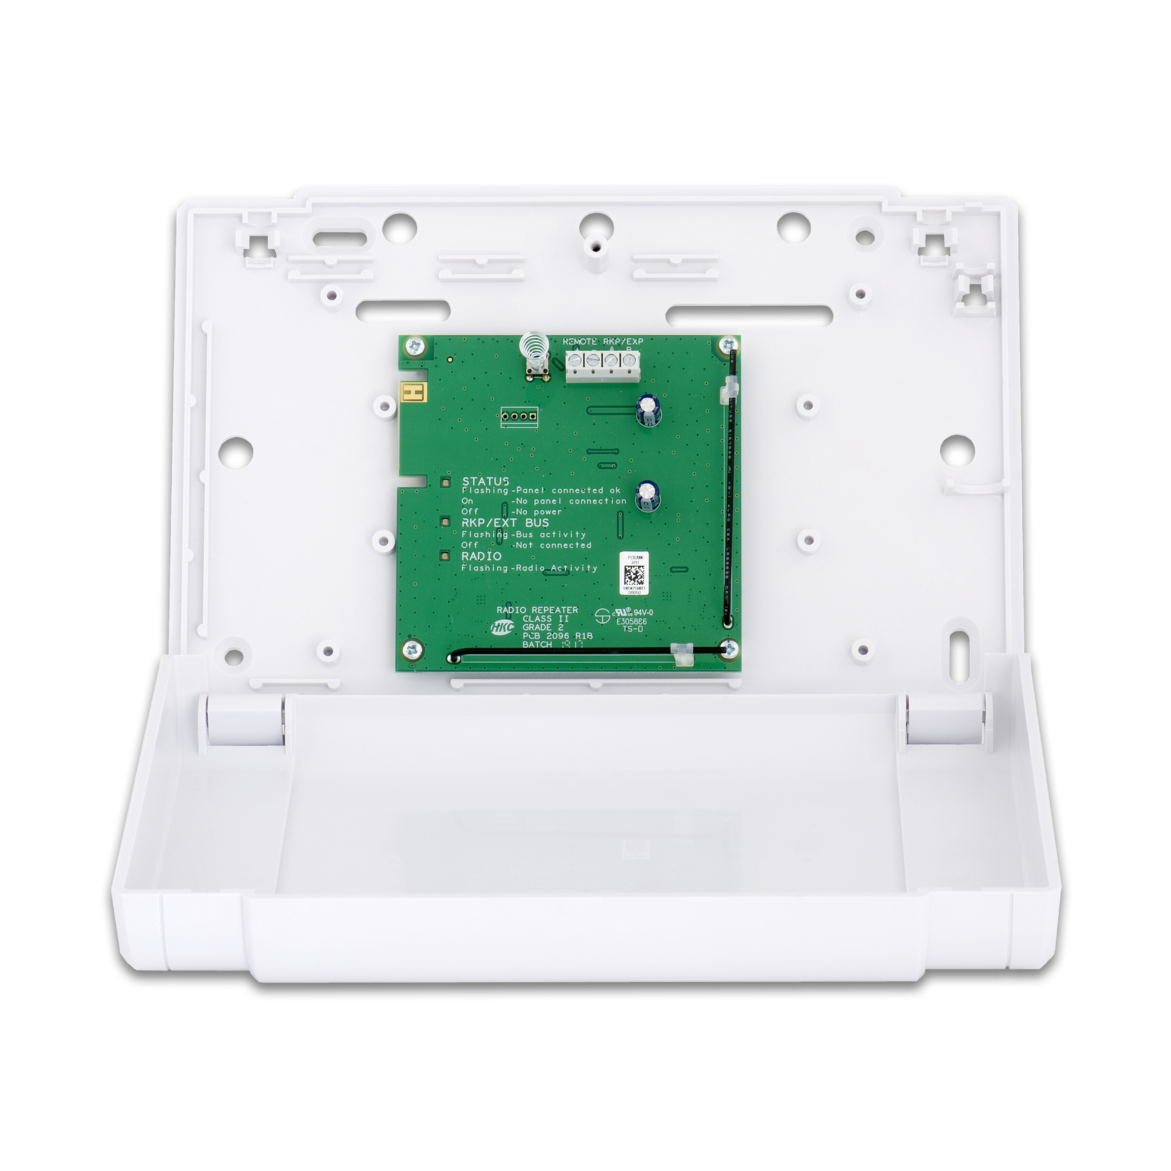
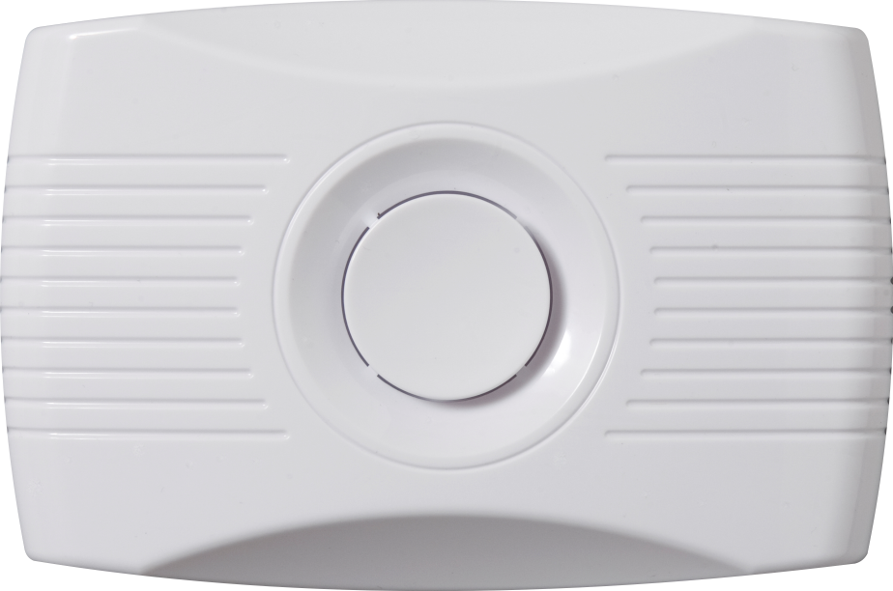
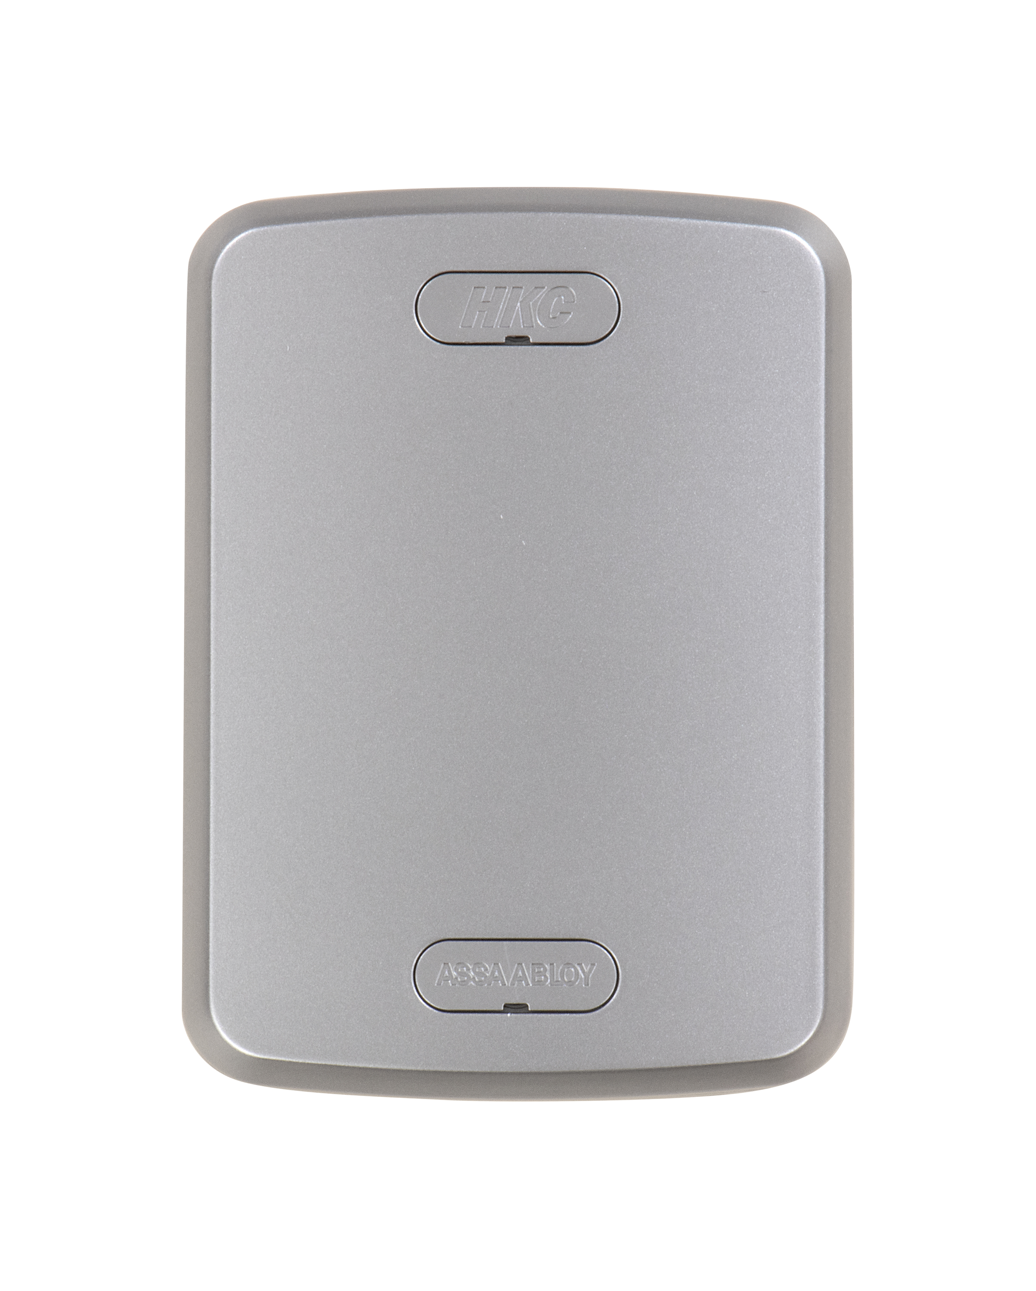
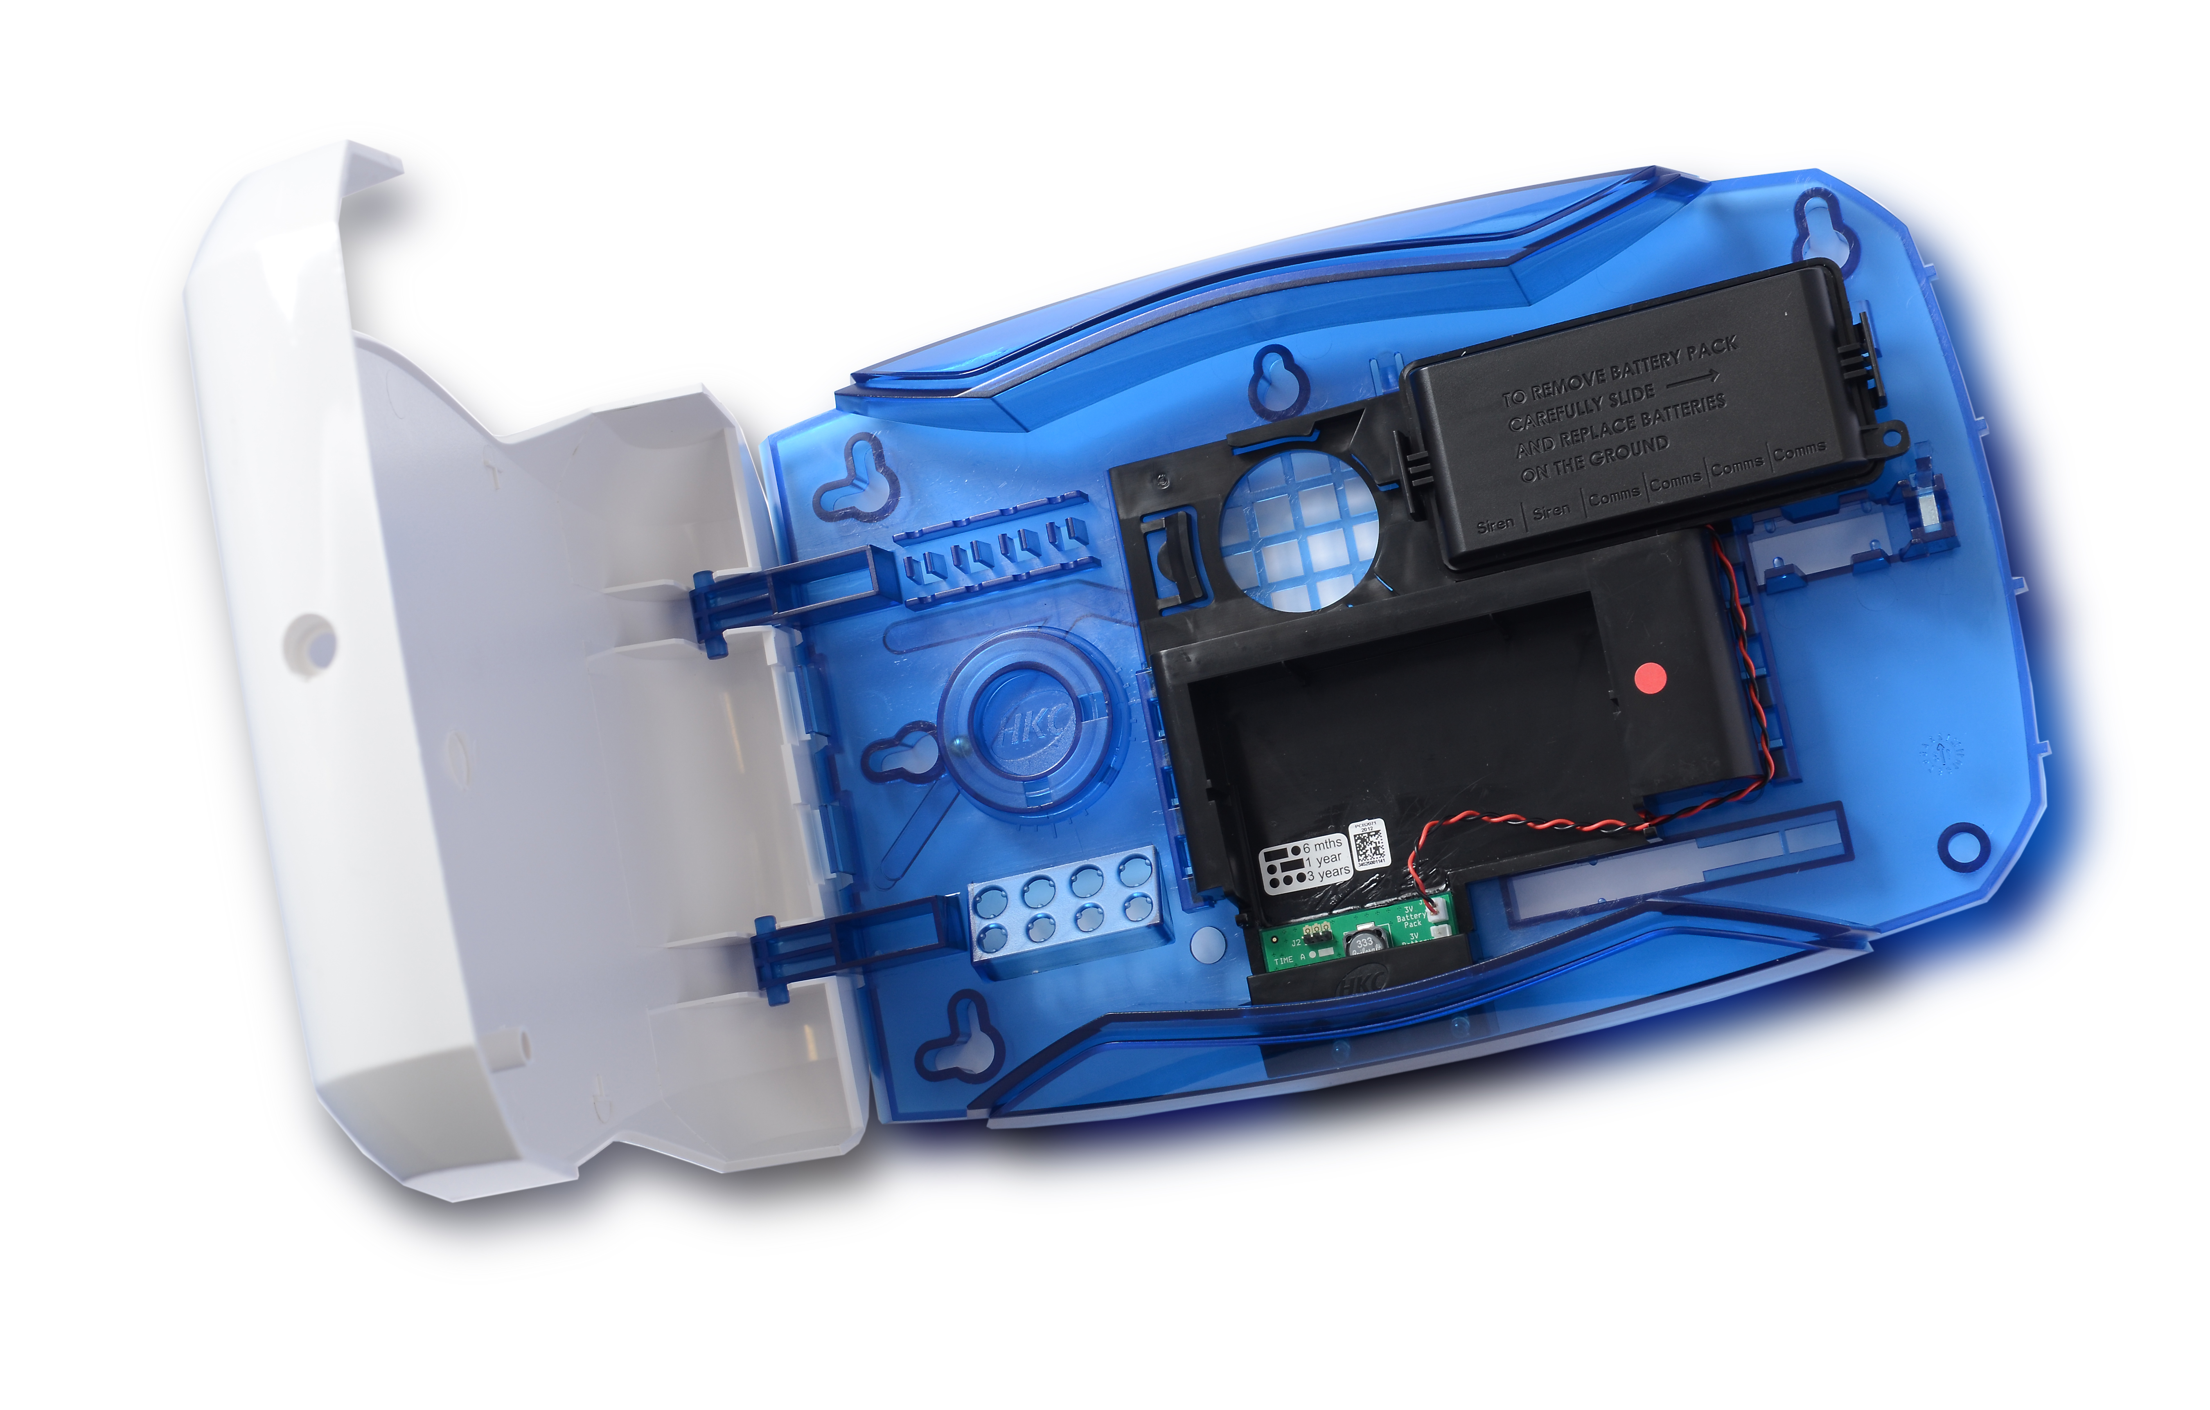
RF Wireless Sounders/Outputs

Slide 10
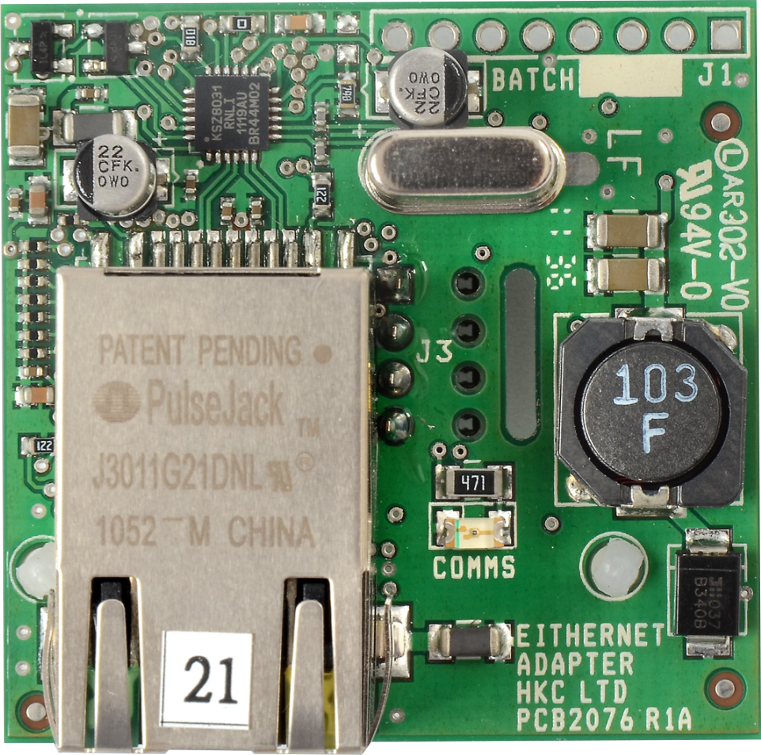
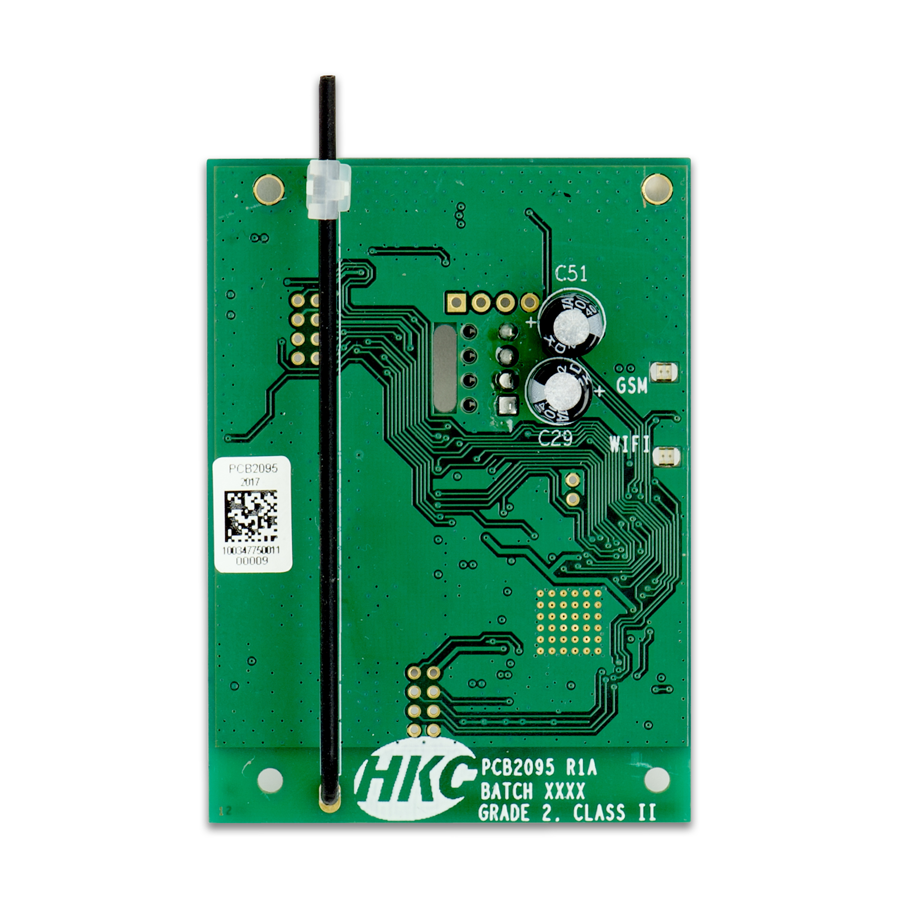
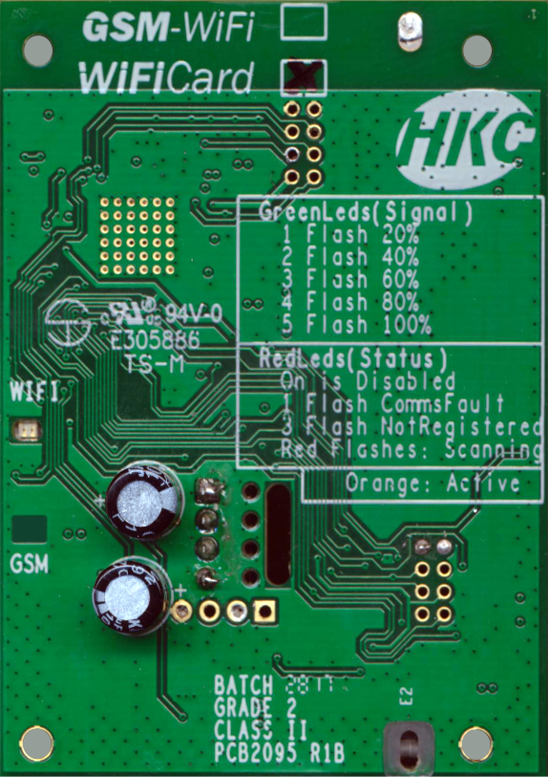
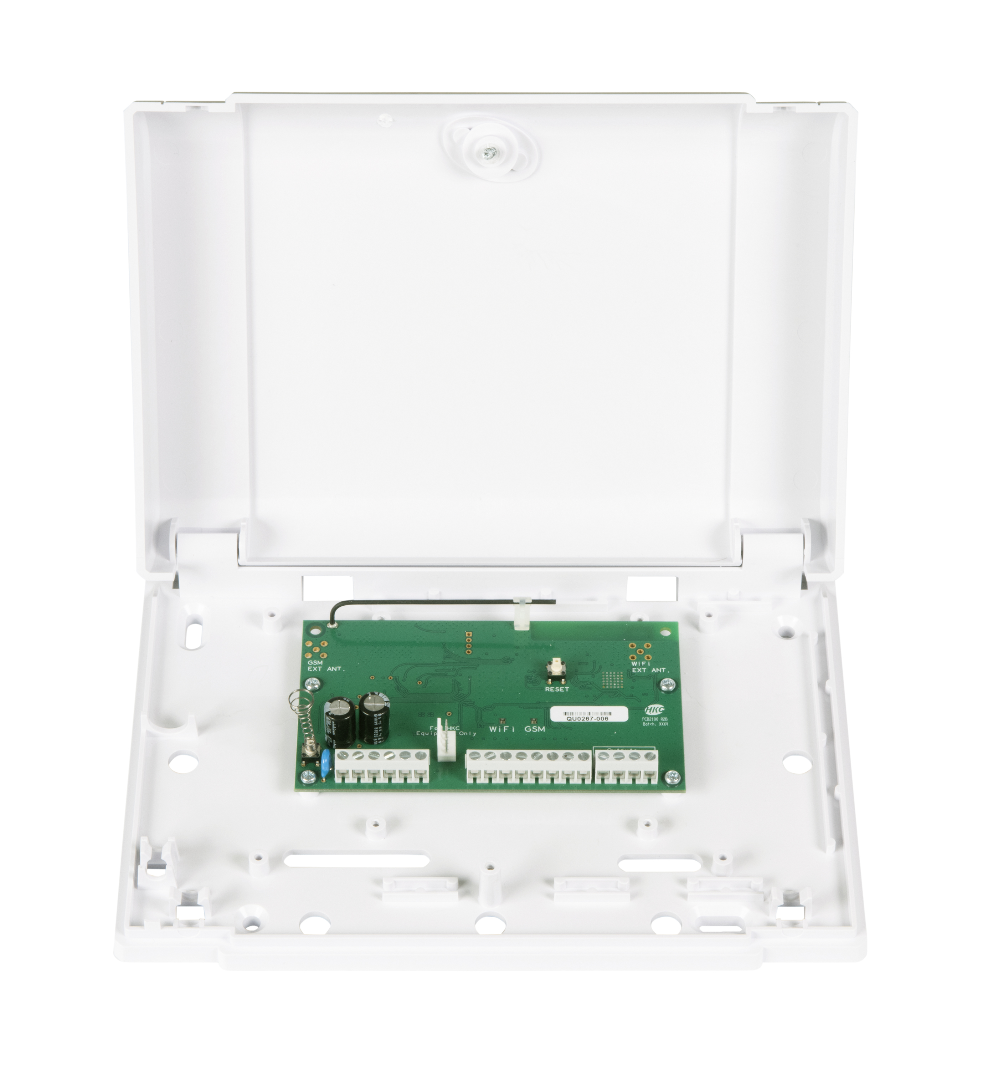
Communication Devices
3 IP Comms Modules
Universal Communicator

Slide 11
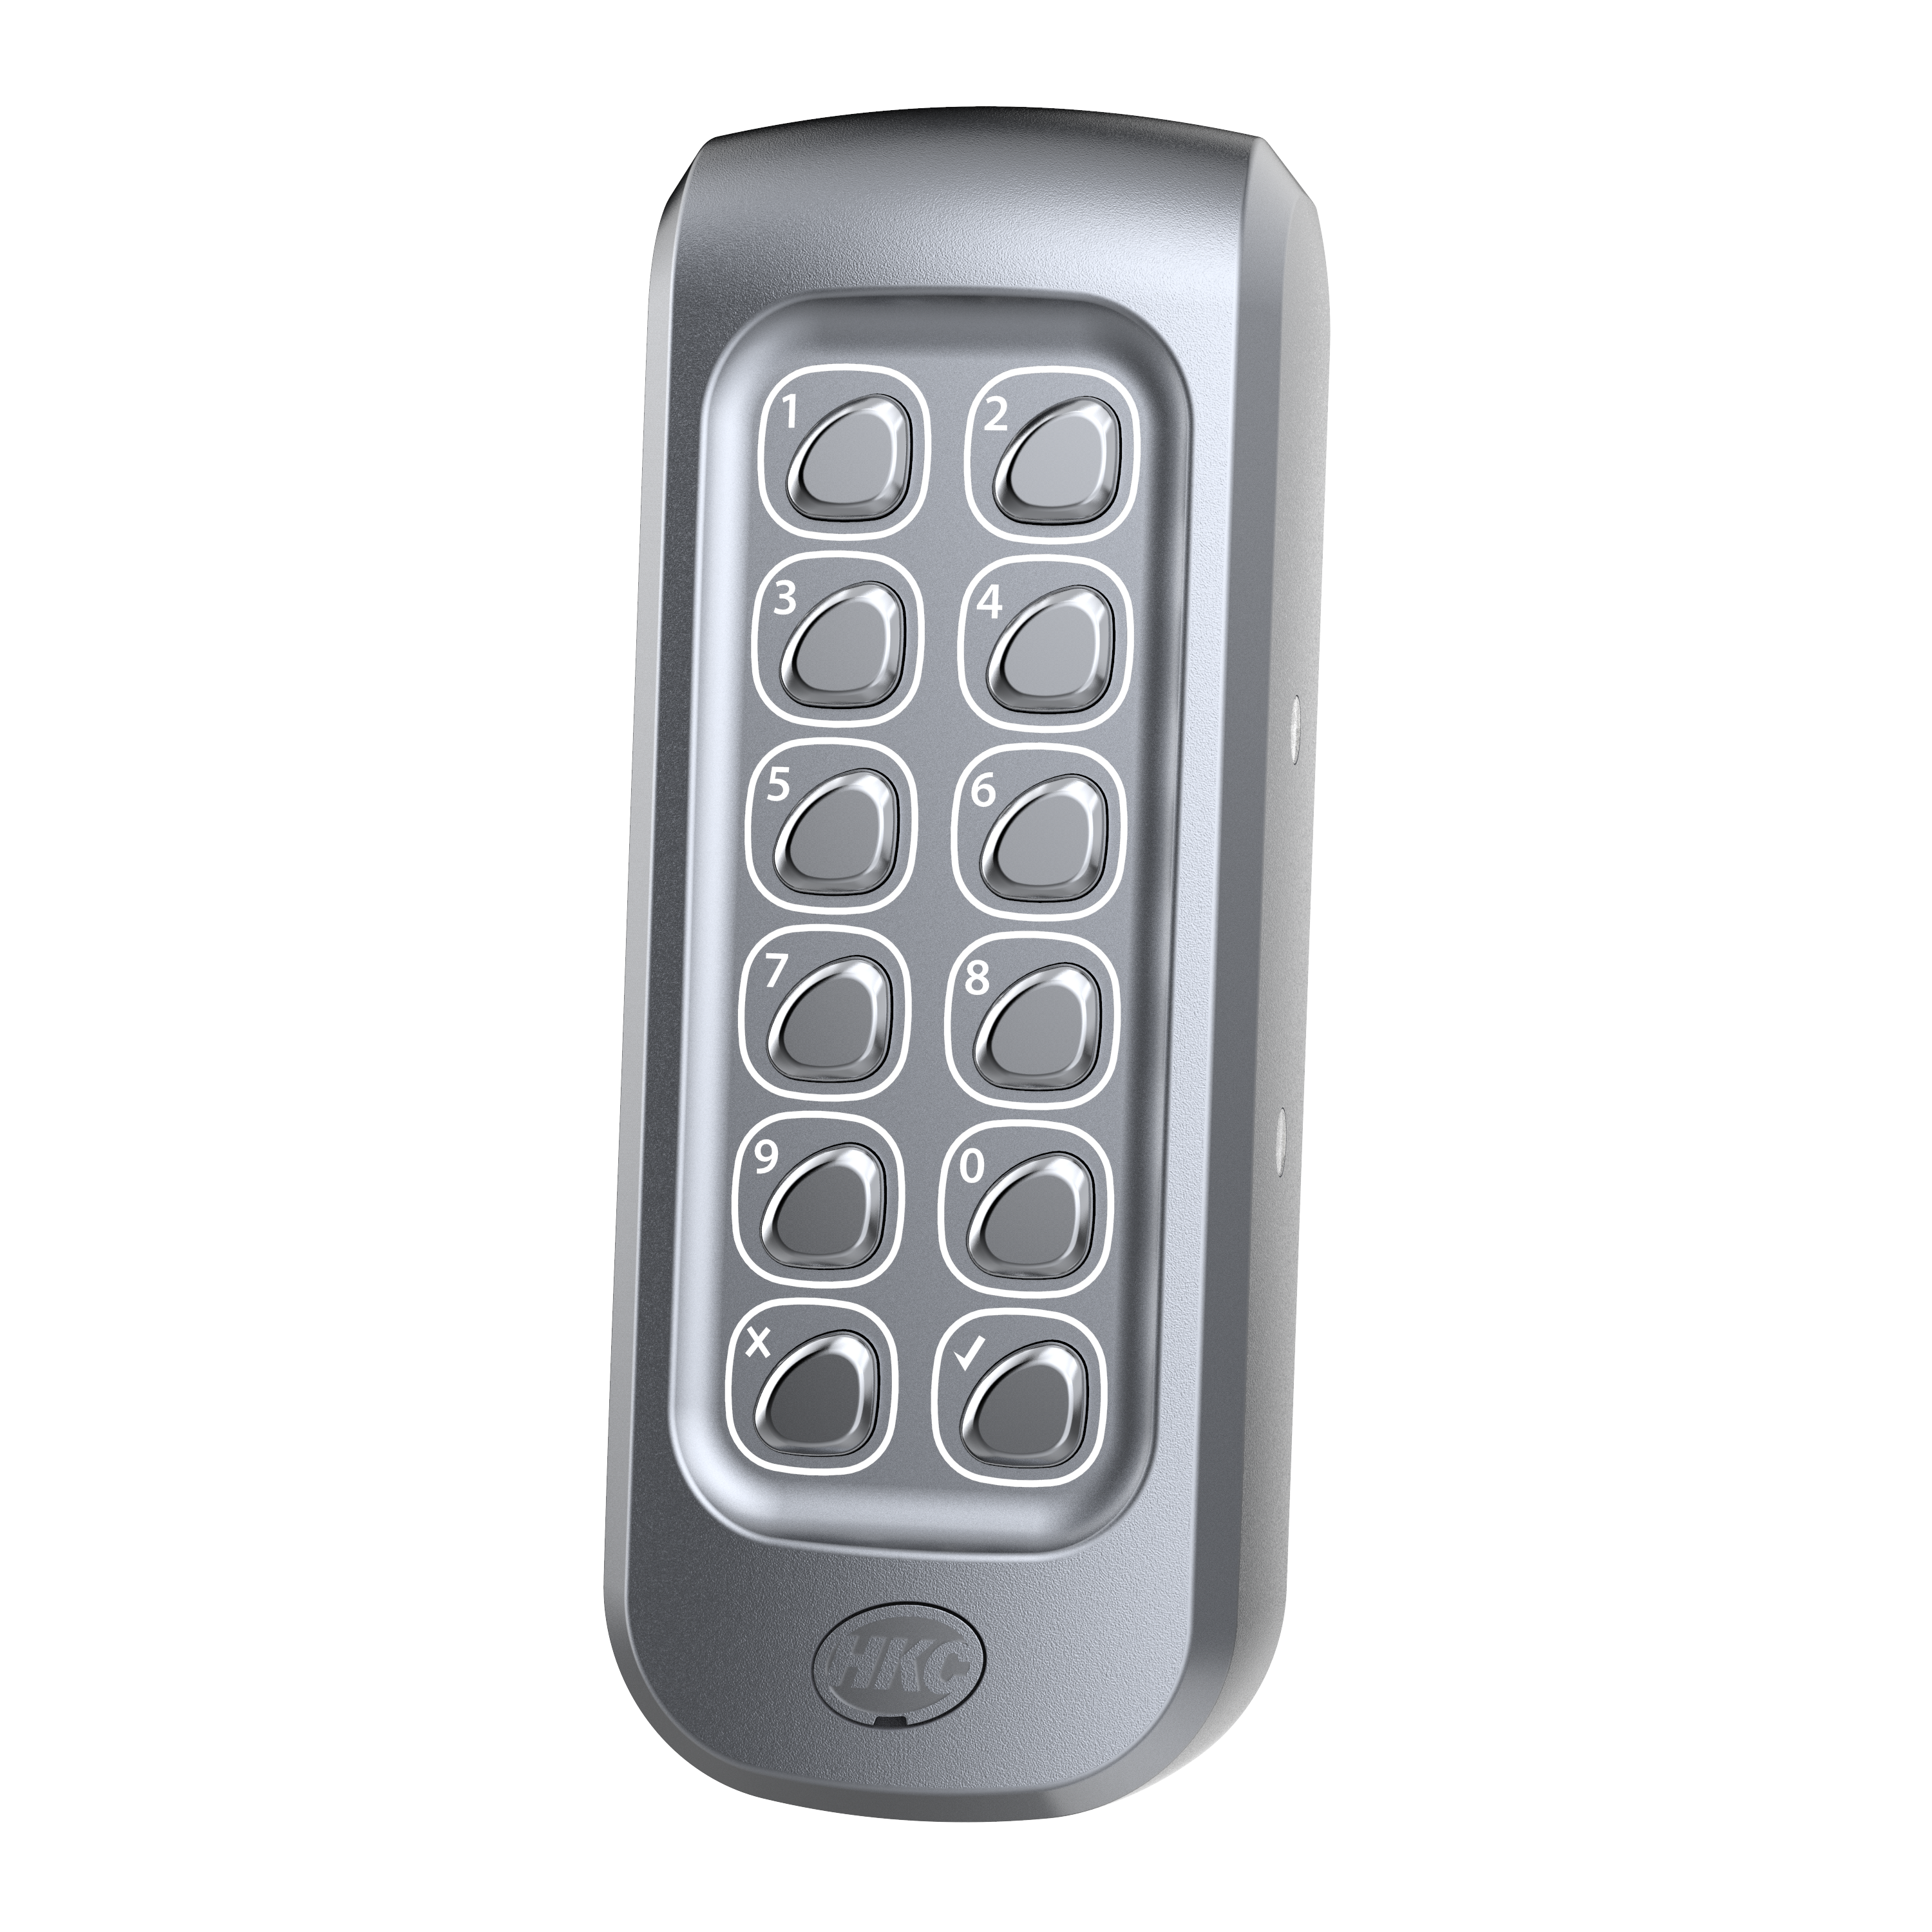
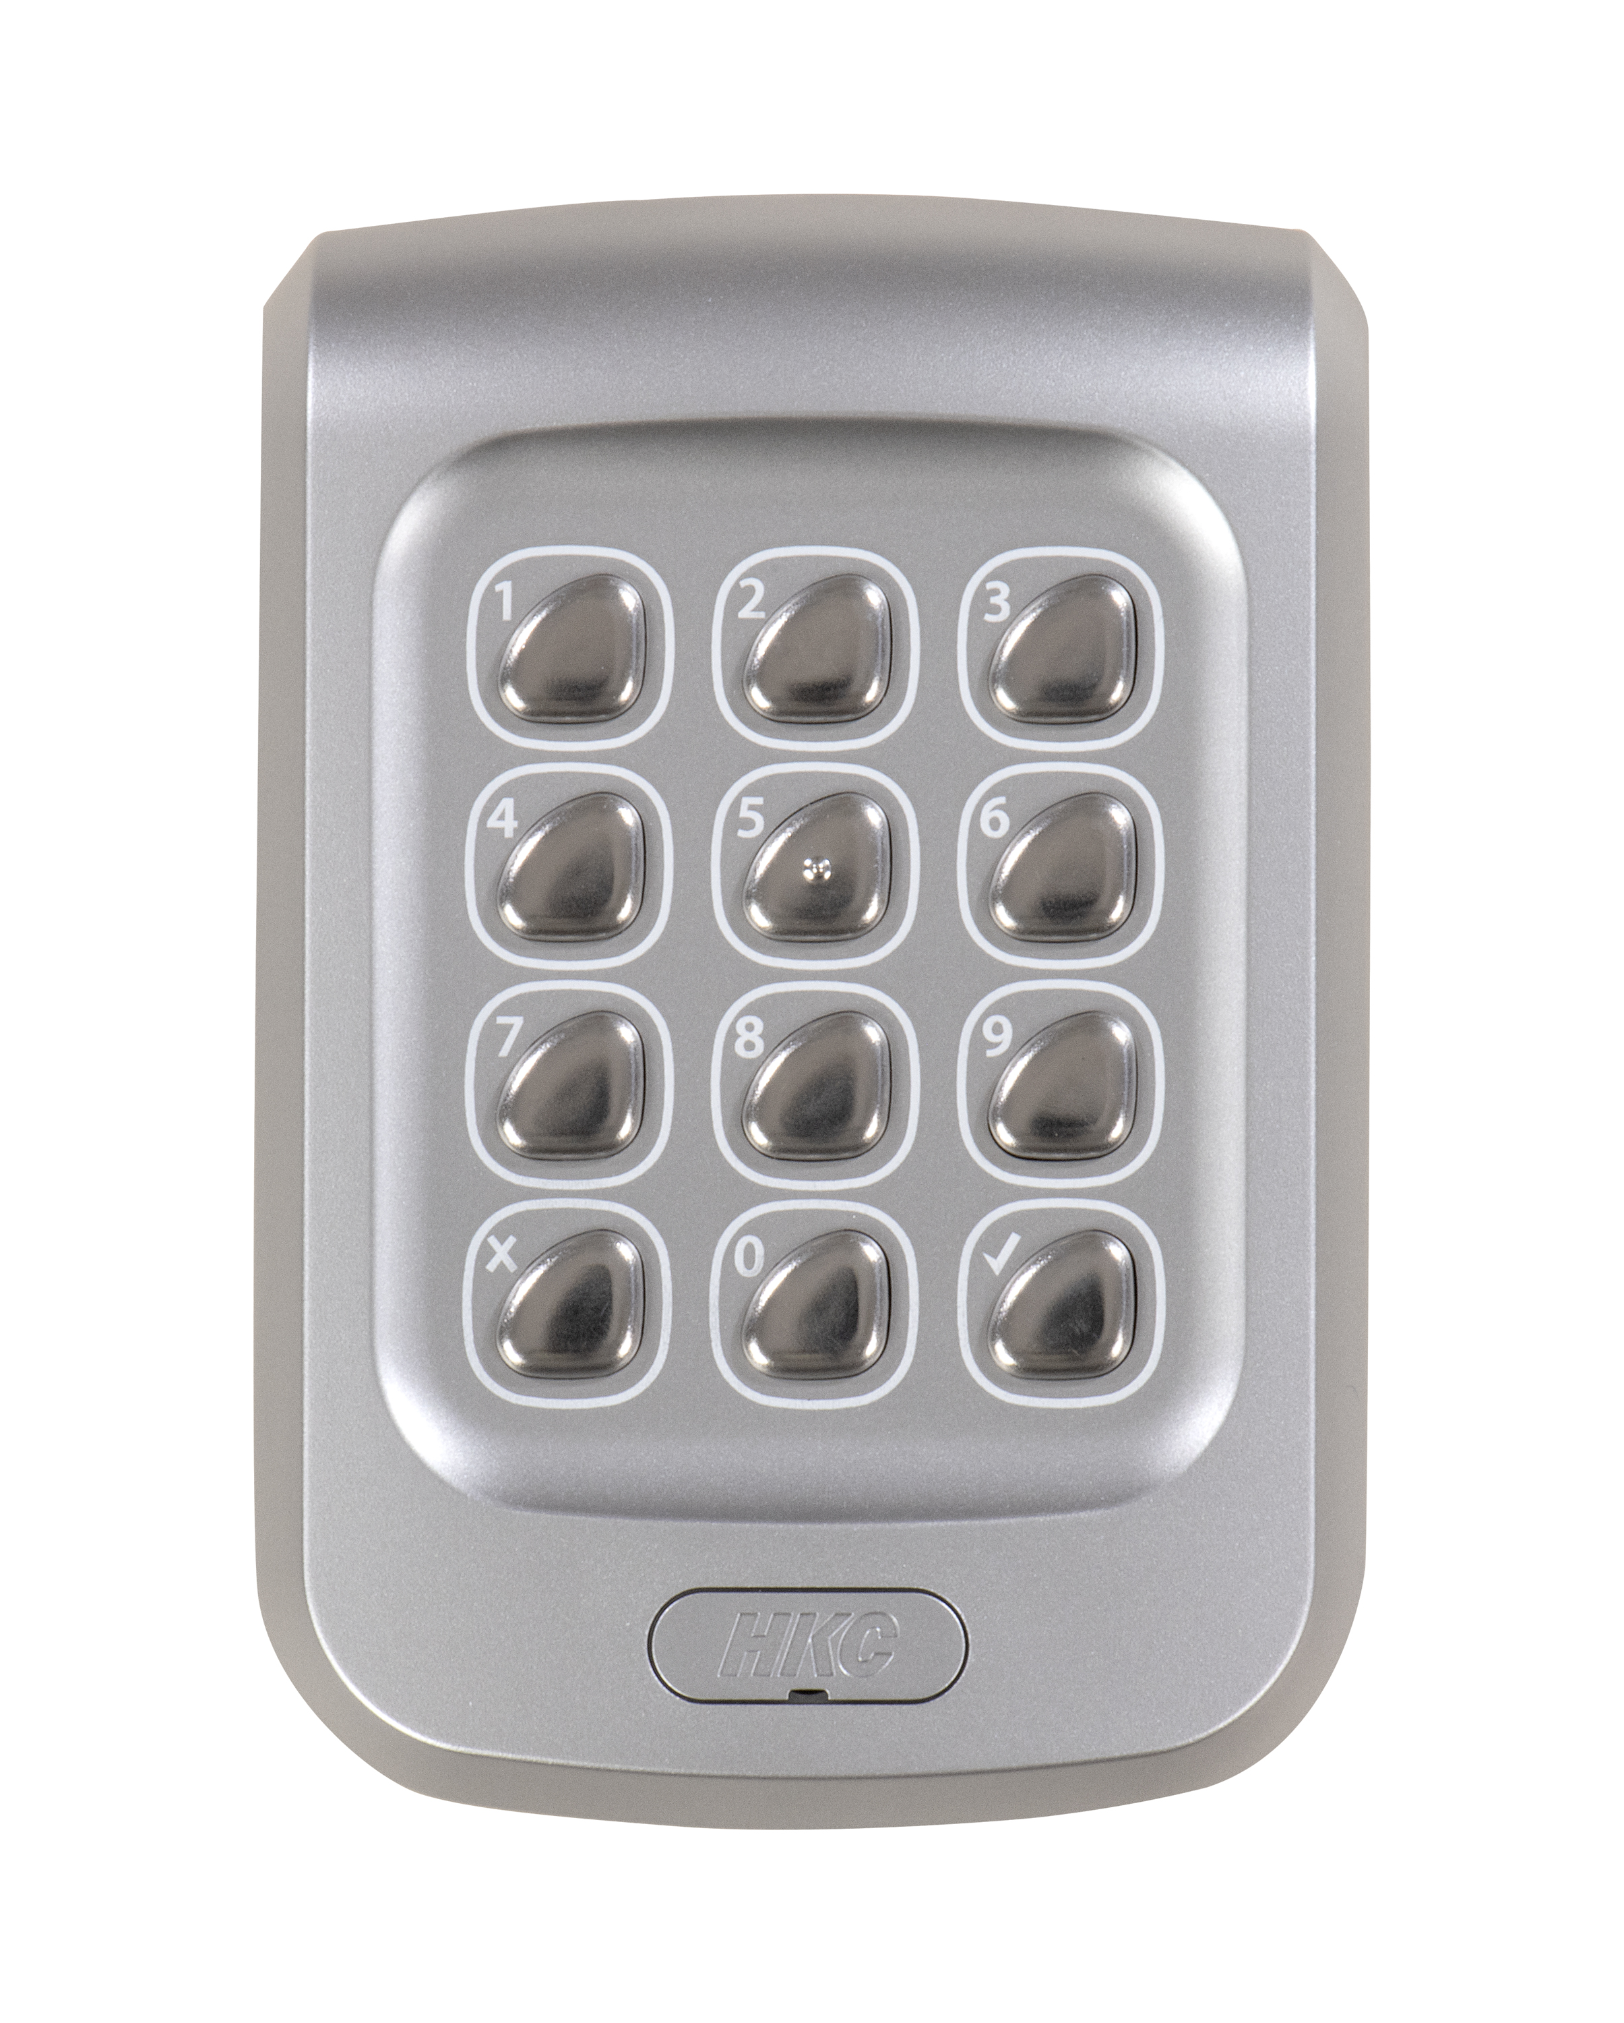
Access Control Devices
Slim and Standard Access Control Keypads incl. RF and 12/24v RF
RF Relay Box for connecting devices

